Slide 1
Summer Student Program at PITZ
- Description of the work and studies done so far
- Studies at PITZ
Anusorn Lueangaramwong
Summer Student Program at PITZ
PITZ‘s control room, 26.07.2012

Slide 2
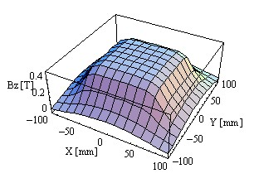
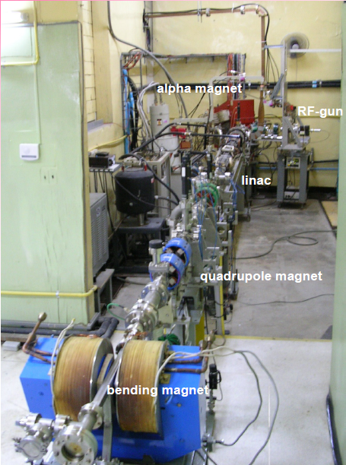
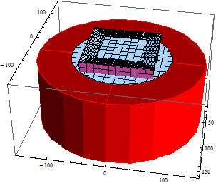
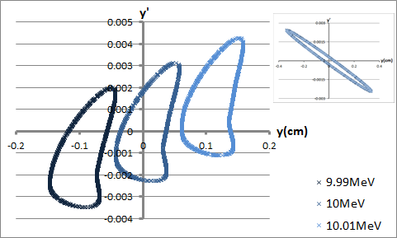
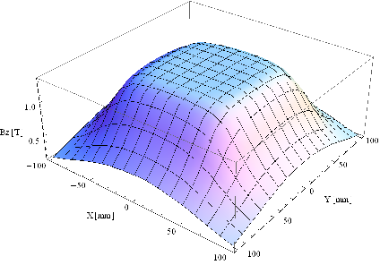
Description of the work and studies done so far
Femtosecond Electron and Photon Pulses Research Laboratory, Chiang Mai University, Thailand
magnetic electron spectrometer
ray tracing calculations
fringe fields of a dipole magnet that affect beam quality
design a electromagnet by RADIA (Mathematica), shimming
alpha magnet
RF-gun
Linac
quadrupole magnet
dipole magnet

Slide 3
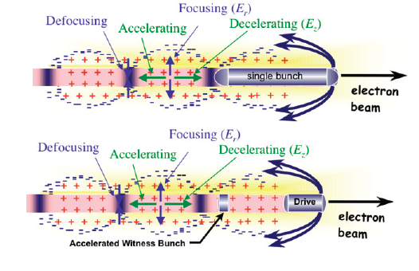
Studies at PITZ
Topic: Particle driven plasma wave acceleration
Specific: Simulation of laser propagation in plasma chamber
Including nonlinearities
By VirtualLab5 software
http://www.symmetrymagazine.org/cms/?pid=1000091, 2012
Hogan M J et al 2010 Plasma wakefield acceleration
experiments at FACET, Nature Physics.

Slide 4
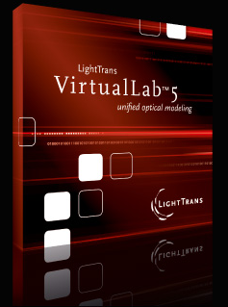
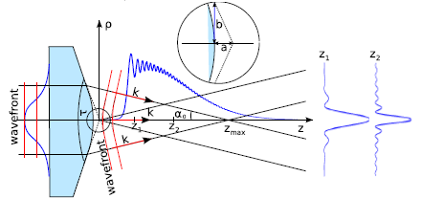
Studies at PITZ
Goals
Learning basics of plasma acceleration, laser beam propagation and ionizaion
Learning how to use VirtualLab5 software
Generate simple setup to simulate laser profile in plasma chamber
Gaussian beam
Axicon
Write final report

Slide 5
End
Thank you for your attention.

