Slide 1
Phase space reconstruction from the slit scan data
M.Krasilnikov,
PPS, 13.10.2011

Slide 2
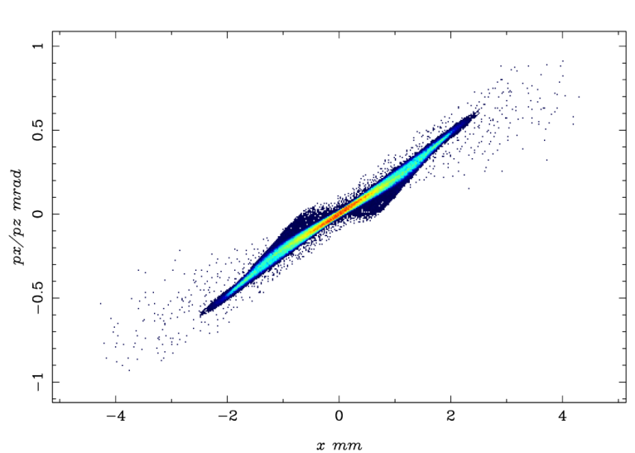
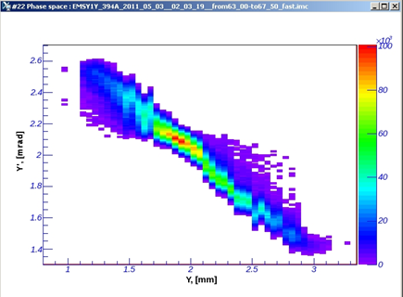
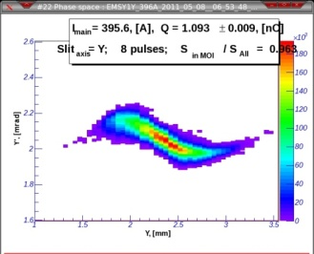
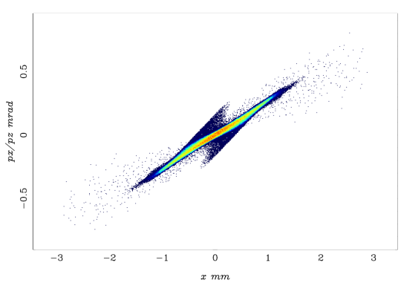
Motivation
Strange anti-correlations: simulated vs. measured phase space
Didactically:
Write down how it should be
Check how it is done in EmWiz / EmCalc
measured
simulated
measured
2nC
1nC

Slide 3
ASTRA simulations

Slide 4
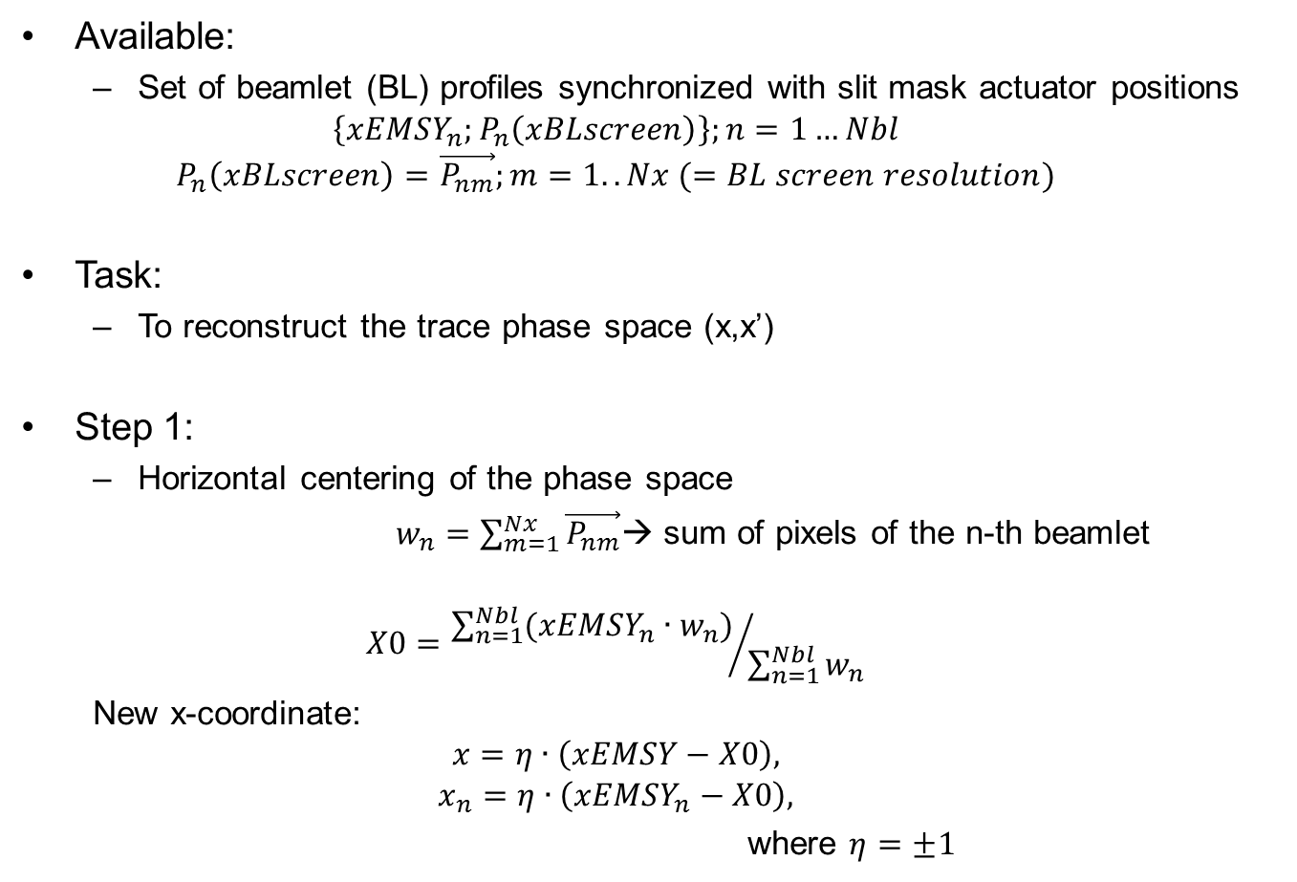
Phase space reconstruction -1
Available:
Set of beamlet (BL) profiles synchronized with slit mask actuator positions
$$\left\{{xEMSY}_{n}^{};P_{n}\left(xBLscreen\right)\right\};n=1…Nbl$$
$$P_{n}\left(xBLscreen\right)=\vec{P_{nm}};m=1..Nx (=BL screen resolution)$$
Task:
To reconstruct the trace phase space (x,x’)
Step 1:
Horizontal centering of the phase space
$w_{n}=\sum_{m=1}^{Nx}{\vec{P_{nm}}}$→ sum of pixels of the n-th beamlet
$$X0={\sum_{n=1}^{Nbl}{({xEMSY}_{n}∙w_{n})}}/{\sum_{n=1}^{Nbl}{w_{n}}}$$
New x-coordinate:
$$x=η∙\left(xEMSY−X0\right),$$
$$x_{n}=η∙\left({xEMSY}_{n}−X0\right),$$
where $η=±1$

Slide 5
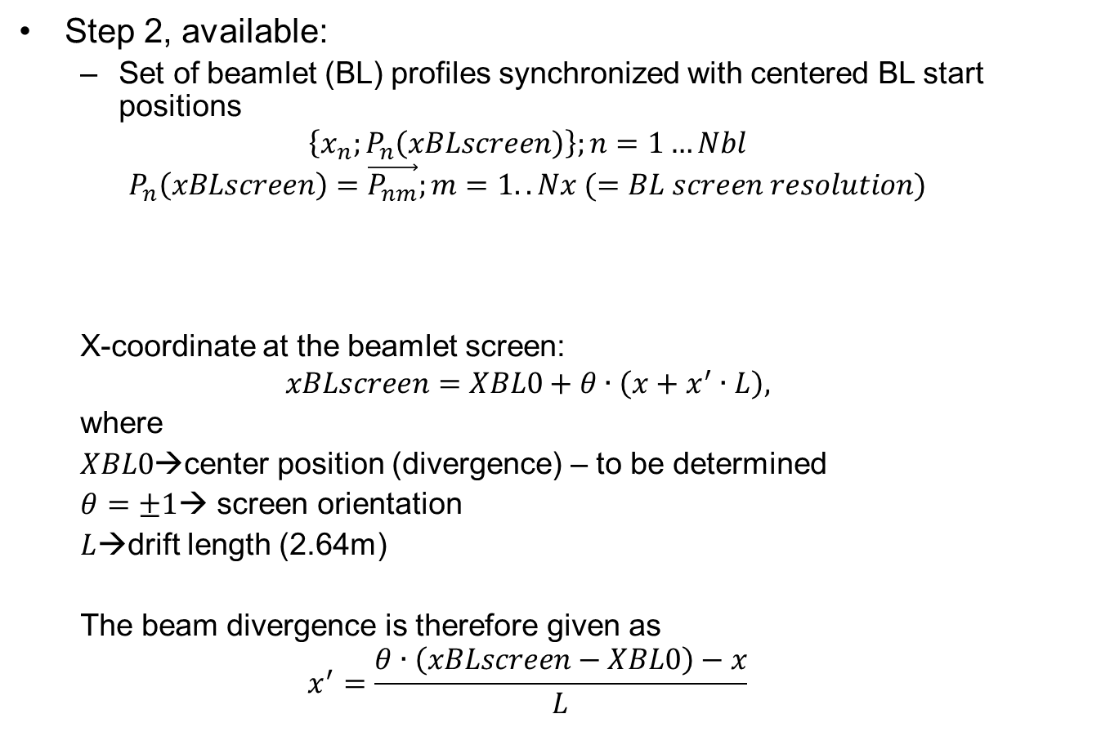
Phase space reconstruction -2
Step 2, available:
Set of beamlet (BL) profiles synchronized with centered BL start positions
$$\left\{x_{n}^{};P_{n}\left(xBLscreen\right)\right\};n=1…Nbl$$
$$P_{n}\left(xBLscreen\right)=\vec{P_{nm}};m=1..Nx (=BL screen resolution)$$
X-coordinate at the beamlet screen:
$$xBLscreen=XBL0+θ∙\left(x+x^{′}∙L\right),$$
where
$XBL0$→center position (divergence) – to be determined
$θ=±1$→ screen orientation
$L$→drift length (2.64m)
The beam divergence is therefore given as
$$x^{′}=\frac{θ∙\left(xBLscreen−XBL0\right)−x}{L}$$

Slide 6
Phase space reconstruction -3
How to determine $XBL0$: $\left\langle x′\right\rangle =0$
The phase space distribution function can be written as
$$F\left(x,x^{′}\right)=\sum_{n=1}^{Nbl}{P_{n}(x^{′})∙Π_{n}(x)}$$
where$P_{n}\left(x^{′}\right)=P_{n}\left(\frac{θ∙\left(xBLscreen−XBL0\right)−x_{n}}{L}\right)$ is the profile of the n-th beamlet, and the${ Π}_{n}(x)$ function represents the x-distribution of the n-th beamlet
$$Π_{n}\left(x\right)=\left\{\begin{matrix}0 & if x<\frac{x_{n}+x_{n−1}}{2} \\ 1 & if\frac{x_{n}+x_{n−1}}{2}≤x≤\frac{x_{n}+x_{n+1}}{2} \\ 0 & if x>\frac{x_{n}+x_{n+1}}{2}\end{matrix}\right.$$
$x_{n−1}$ $x_{n}$ $x_{n+1}$

Slide 7
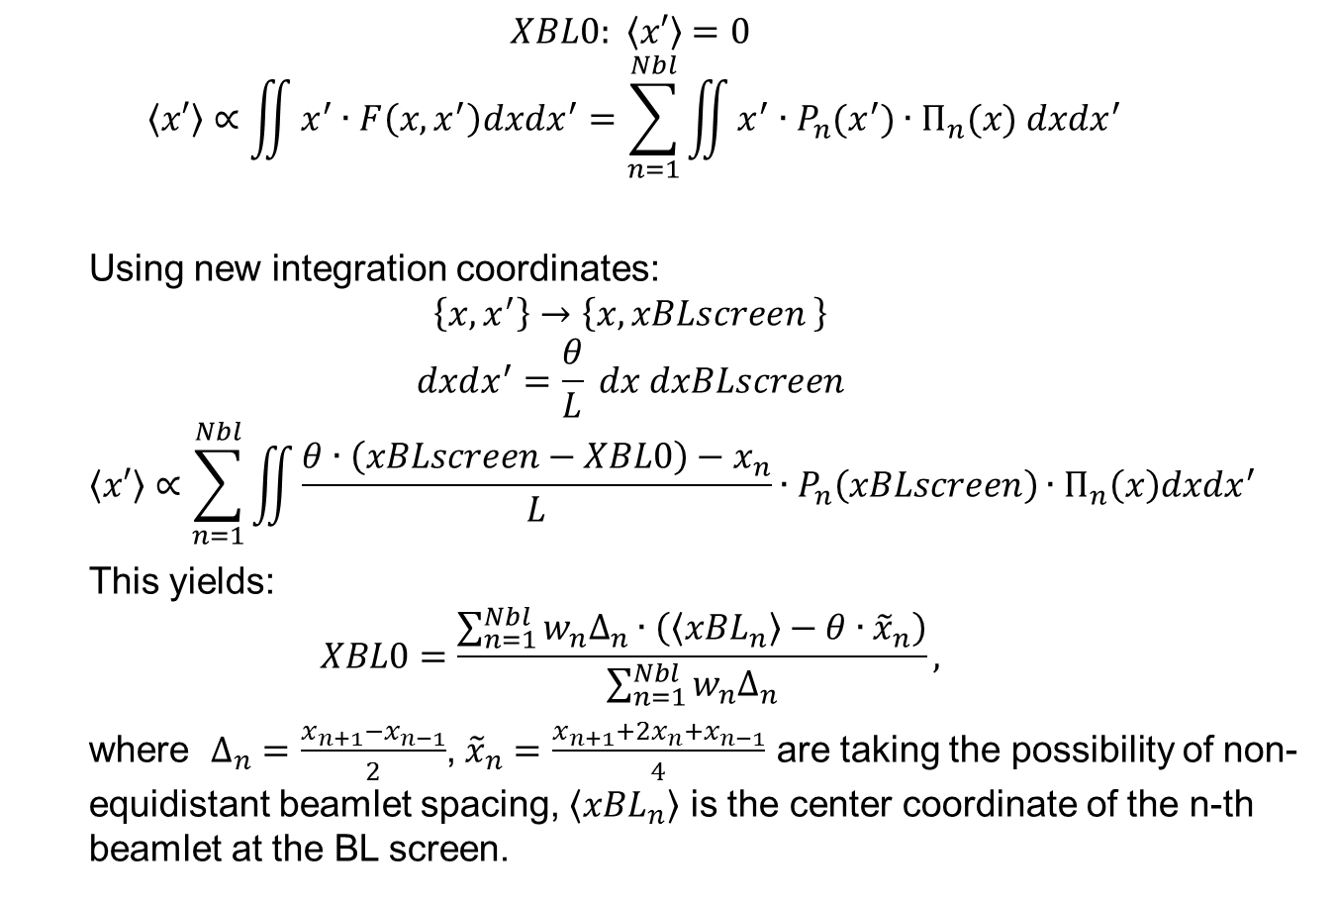
Phase space reconstruction -4
$$XBL0\text{:} \left\langle x′\right\rangle =0$$
$$\left\langle x′\right\rangle ∝\iint{x^{′}∙F\left(x,x^{′}\right)dxdx^{′}}=\sum_{n=1}^{Nbl}{\iint{x^{′}∙P_{n}(x^{′})∙Π_{n}(x) dxdx^{′}}}$$
Using new integration coordinates:
$$\left\{x,x^{′}\right\}→\left\{x,xBLscreen \right\}$$
$$dxdx^{′}=\frac{θ}{L} dx dxBLscreen$$
$$\left\langle x′\right\rangle ∝\sum_{n=1}^{Nbl}{\iint{\frac{θ∙\left(xBLscreen−XBL0\right)−x_{n}}{L}∙P_{n}\left(xBLscreen\right)∙Π_{n}\left(x\right)dxdx^{′}}}$$
This yields:
$$XBL0=\frac{\sum_{n=1}^{Nbl}{w_{n}Δ_{n}∙\left(\left\langle {xBL}_{n}\right\rangle −θ∙{\tilde{x}}_{n}\right)}}{\sum_{n=1}^{Nbl}{w_{n}Δ_{n}}},$$
where $Δ_{n}=\frac{x_{n+1}−x_{n−1}}{2}$, ${\tilde{x}}_{n}=\frac{x_{n+1}+{2x}_{n}+x_{n−1}}{4}$ are taking the possibility of non-equidistant beamlet spacing, $\left\langle {xBL}_{n}\right\rangle$ is the center coordinate of the n-th beamlet at the BL screen.

Slide 8
Phase space reconstruction: summary
Step 1:
Horizontal centering of the phase space
$X0={\sum_{n=1}^{Nbl}{({xEMSY}_{n}∙w_{n})}}/{\sum_{n=1}^{Nbl}{w_{n}}}$
$x_{n}=η∙\left({xEMSY}_{n}−X0\right),$ where $η=±1$
Step 2:
Vertical centering of the phase space
$XBL0=\frac{\sum_{n=1}^{Nbl}{w_{n}Δ_{n}∙\left(\left\langle {xBL}_{n}\right\rangle −θ∙{\tilde{x}}_{n}\right)}}{\sum_{n=1}^{Nbl}{w_{n}Δ_{n}}},$where $Δ_{n}=\frac{x_{n+1}−x_{n−1}}{2}$, ${\tilde{x}}_{n}=\frac{x_{n+1}+{2x}_{n}+x_{n−1}}{4}$
$P_{n}\left({xBLscreen}_{m}\right)=P_{n}\left(XBL0+θ∙\left(x_{n}+{x′}_{m}∙L\right)\right)=P_{n}\left({x′}_{m}\right)$.
Step 3:
Interpolating (extrapolating) of each beamlet profile $P_{n}\left({x′}_{m}\right)$ over the unique (for all beamlets) divergence grid ${\{x′}_{k}\}$.

