Slide 1
Laser Pointing Stability: measurement Results
PPS 2nd August 2011
Matthias Groß

Slide 2
Laser beam pointing stability measurements March-July 2011
M1
Shaft
1) On the Laser table:
Near field
Far field
12m (distance to M3)
2) In the shaft:
4 positions
3) In the tunnel:
After M3
VC1, VC2
Measurement time: 10min
Pos1
Pos2
Lens1
Lens2
Pos3
Pos4
Shutter
M2

Slide 3
Overview
μm
Yrms
Xrms

Slide 4
Overview

Slide 5
Jitter divided by Beam Size
μm
Yrms
Xrms

Slide 6
Laser beam pointing stability measurements March-July 2011
Location | Xrms (μm) of beam position | Xrms beam size (mm) | Yrms (μm) of beam position | Yrms beam size (mm)
Laser hut Near field camera | 2.8 | 0.4 | 1.8 | 0.3
Laser hut Far field camera | 2.4 | 0.3 | 5.3 | 0.4
Shaft position 1 | 6.0 | 0.8 | 7.0 | 0.9
Shaft position 2 | 10.2 | 0.8 | 10.0 | 1.1
Shaft position 3 | 12.5 | 1.1 | 6.8* | 0.8
Shaft position 4 | 14.7 | 0.8 | 11.3* | 0.9
Equivalent M3 position on laser table | 8.1 | 0.9 | 7.8 | 0.8
Tunnel near M3 (Shaft vent on) | 17.8 | 1.4 | 14.1 | 1.1
Tunnel near M3 (Shaft vent off) | 15.0 | 1.4 | 13.9 | 1.1
Tunnel VC1 (no BSA) | 16.5 | 1.3 | 13.1 | 1.1
Tunnel VC2 (no BSA) | 15.3 | 1.5 | 15.1 | 1.1
Tunnel VC2 (BSA 0.8mm) | 4.2 | 0.2 | 5.6 | 0.2
*Beam spot is cut

Slide 7
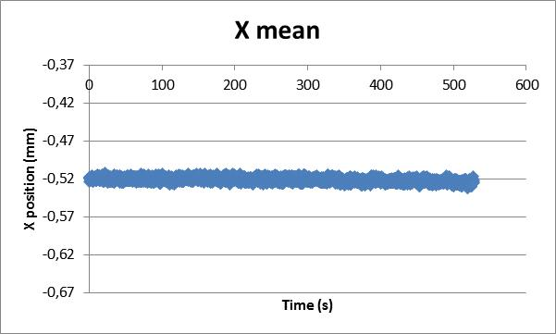
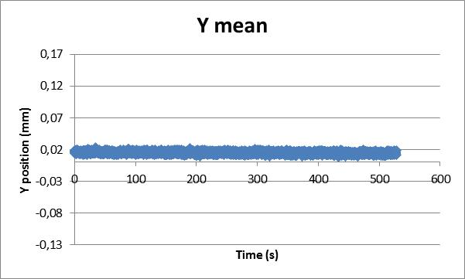
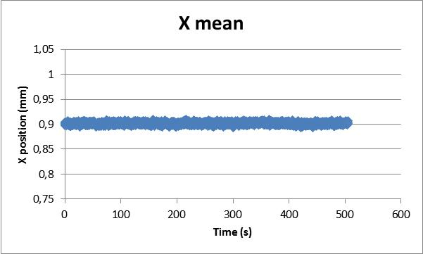
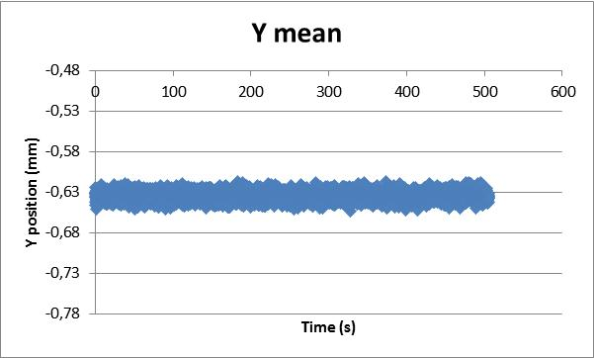
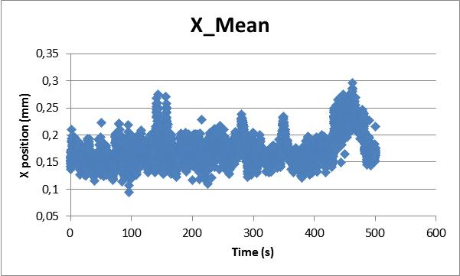
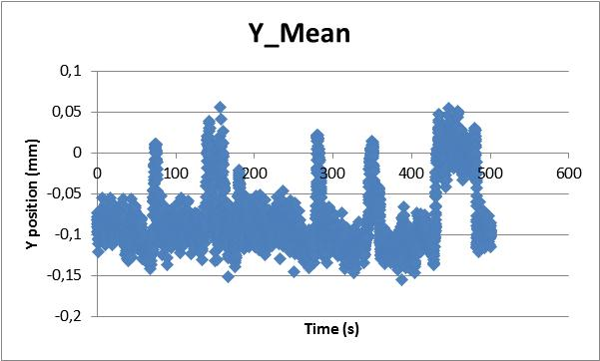
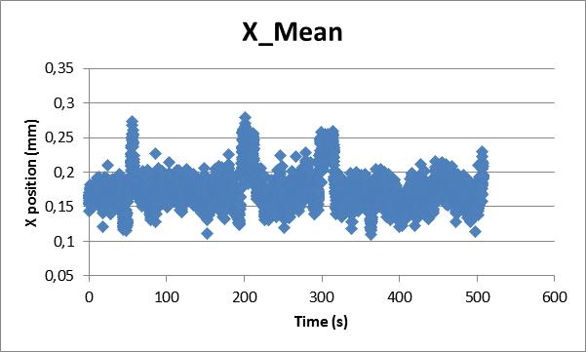
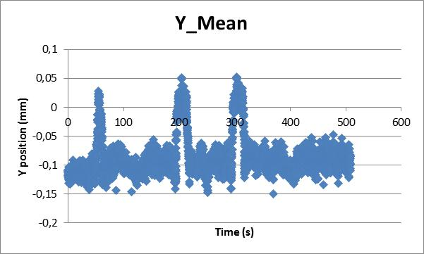
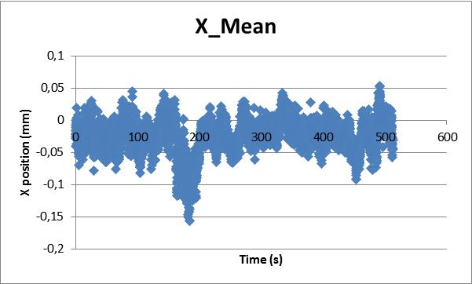
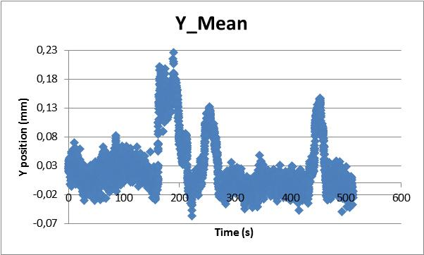
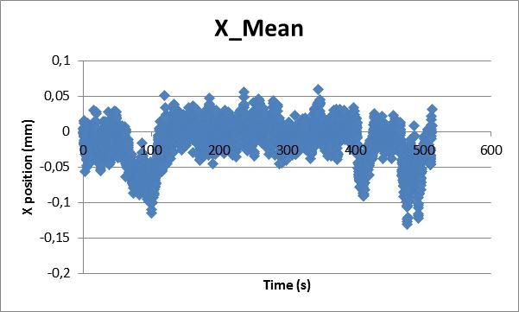
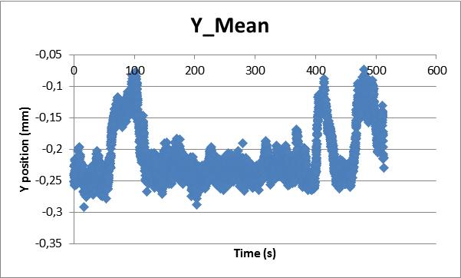
Near Field
Far Field
Shaft with ventilation
Shaft without ventilation
VC1
VC2

Slide 8
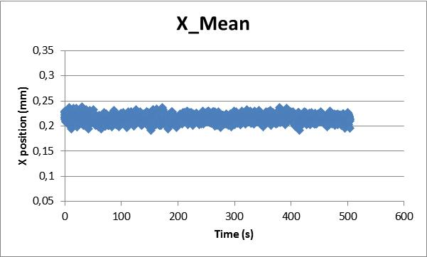
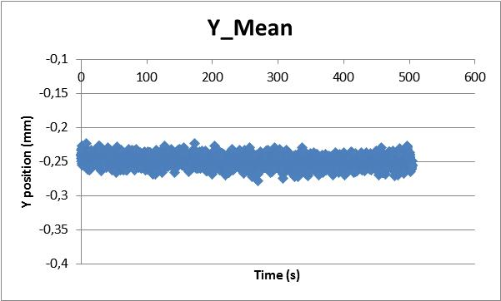
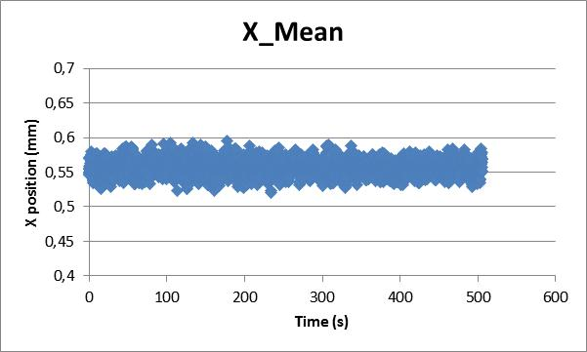
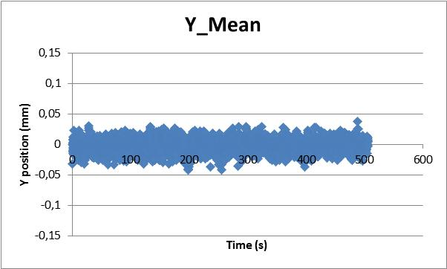
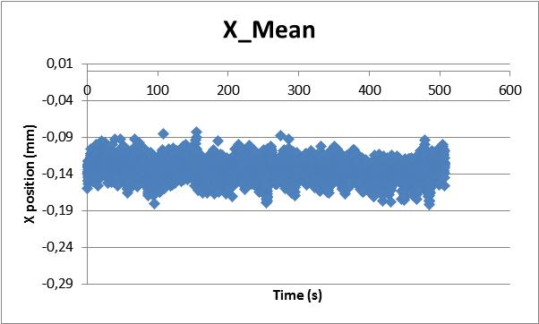
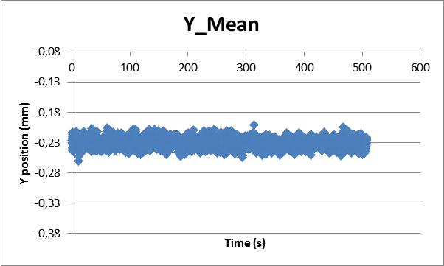
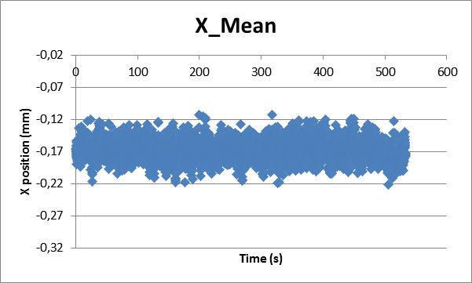
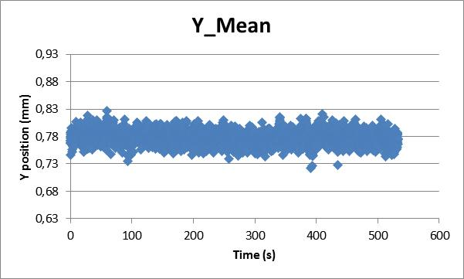
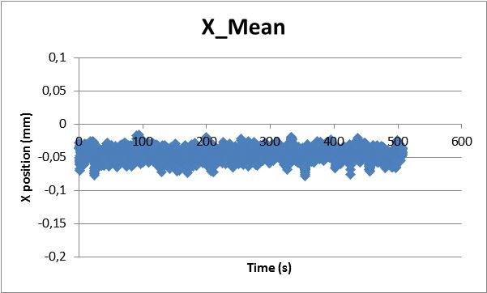
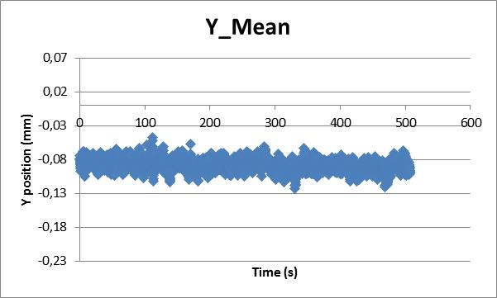
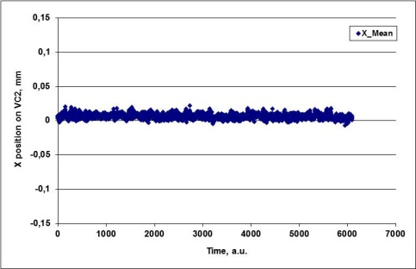
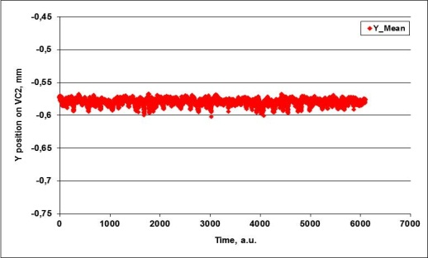
Shaft Pos1
Shaft Pos2
Shaft Pos3
Shaft Pos4
12m on laser table
VC2 with BSA

